Slide 1
Azure AI Workshop
Viktor Tsykunov
Principal Software Engineering Lead
Commercial Software Engineering
vtsykun@microsoft.com

Slide 2
Challenge 0: Environment Setup
Get Workshop materials from GIT: https://github.com/vityabool/aiworkshop.git
Create Microsoft Account (http://account.microsoft.com)
Activate Azure Subscription
Log-in to https://portal.azure.com
Create Data Science Virtual Machine (DSVM) Ubuntu. Choose any machine with GPU, like Standard NC6 (6 vcpus, 56 GB memory)

Slide 3
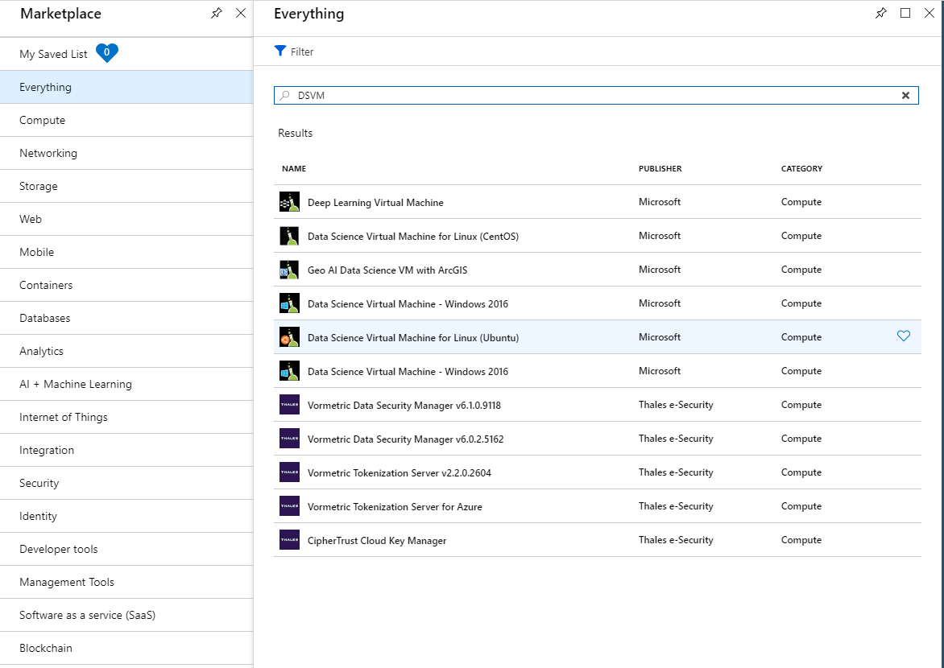
Challenge 0. Steps
Azure portal ->
Create new resource

Slide 4
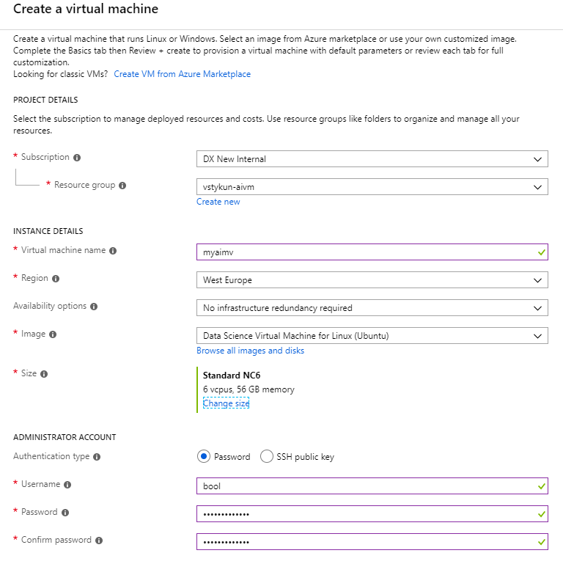
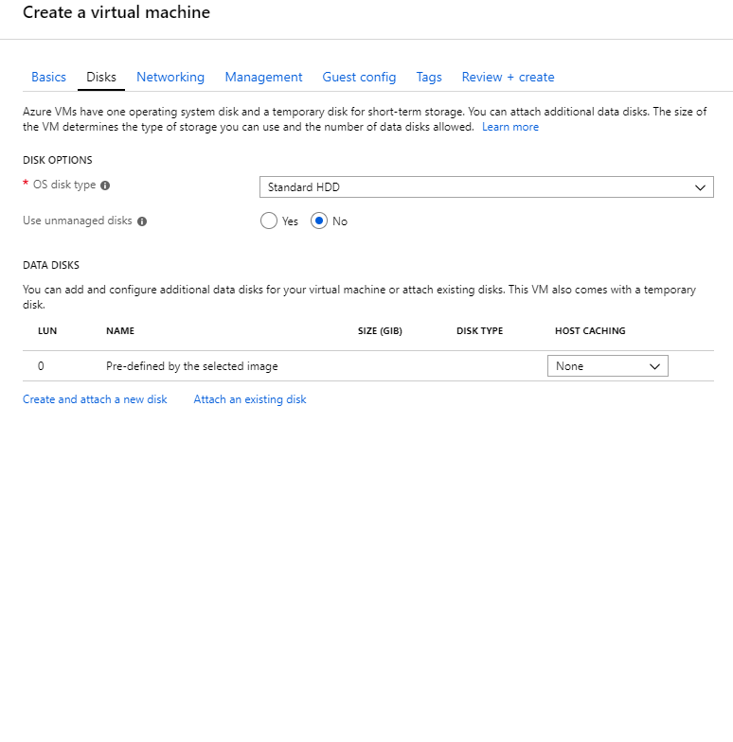
Challenge 0. Steps. Create VM

Slide 5
Challenge 0. Steps. Create VM

Slide 6
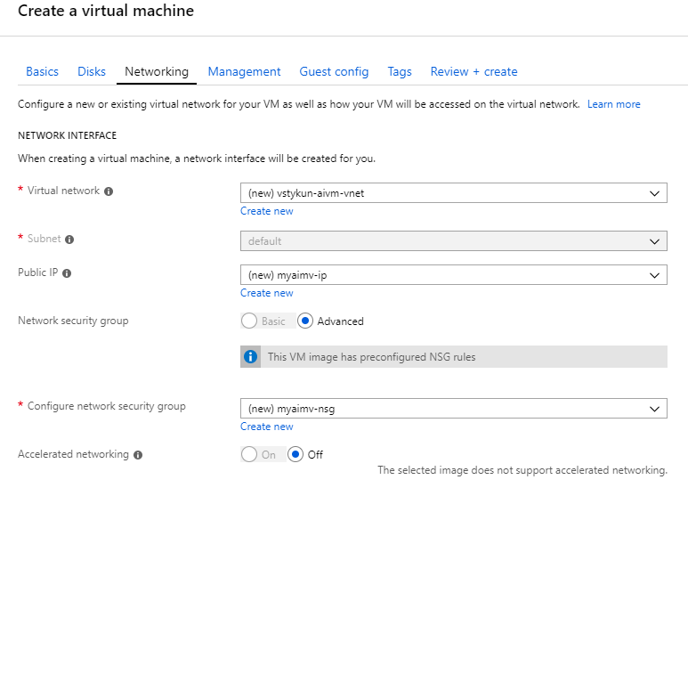
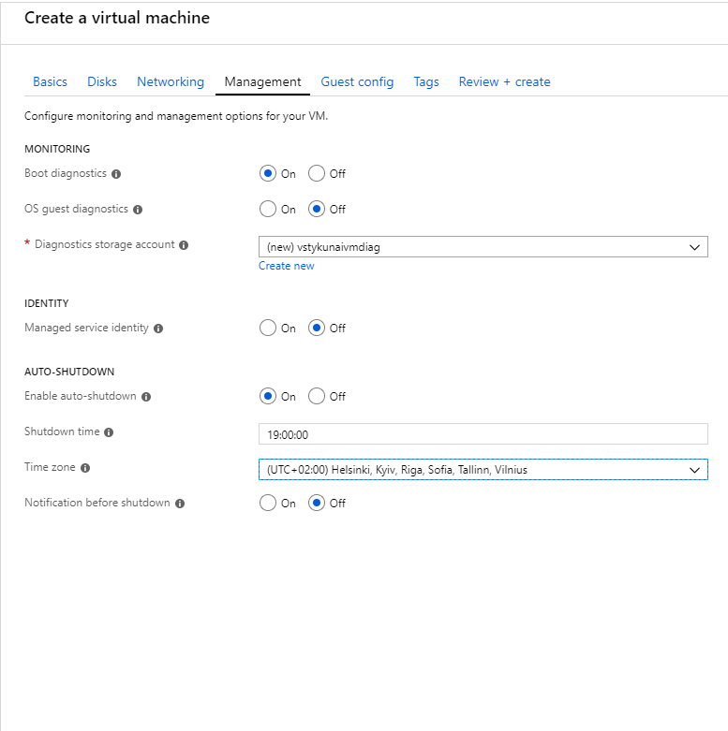
Challenge 0. Steps. Create VM

Slide 7
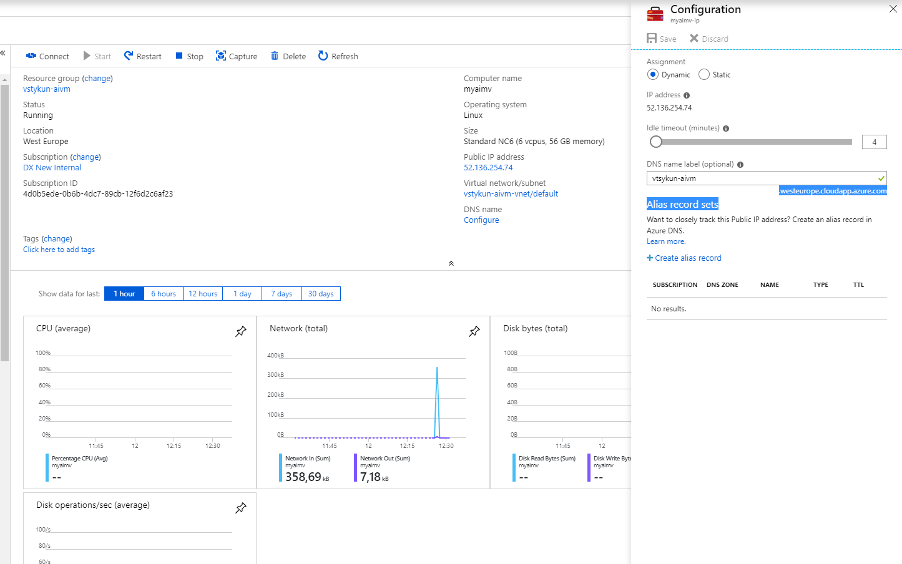
Challenge 0. Steps. Assign DNS name to the VM

Slide 8
Challenge 0: Environment Setup
Login to Jupiter server: http://(Server IP):8000
SSH to the VM with SSH client (like Putty: https://www.putty.org)
Clone git repository (https://github.com/vityabool/aiworkshop.git) to the local PC
Clone this git repository to DSVM into ~/notebooks
Unzip images. Run on the server shell: cd ~/notebooks/aiworkshop/data ; unzip gear_images.zip

Slide 9
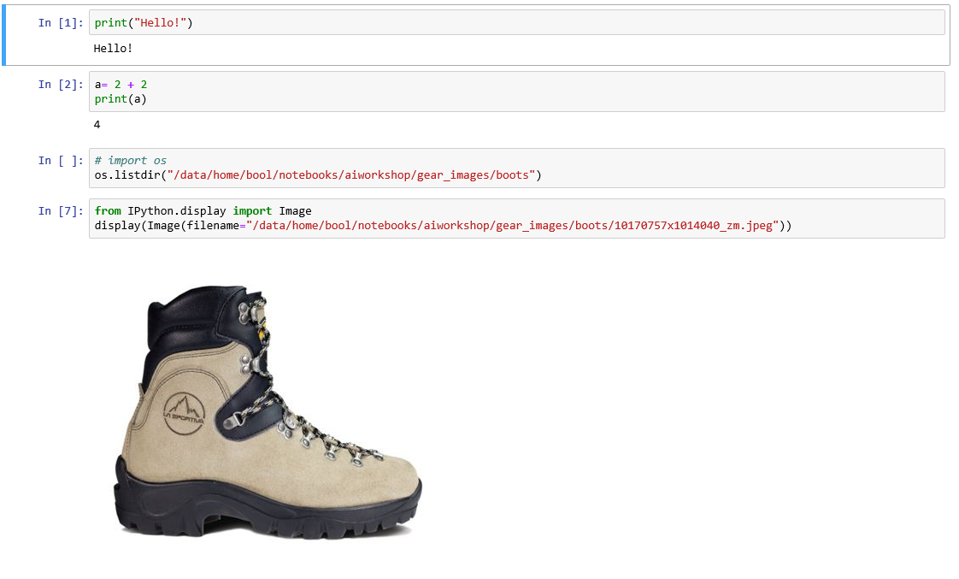
Challenge 0. Testing Jupyter with Python

Slide 10
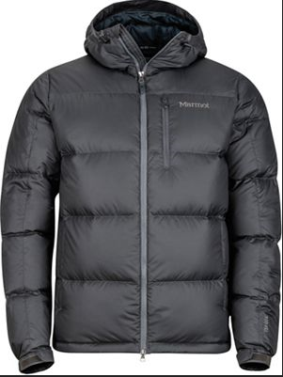
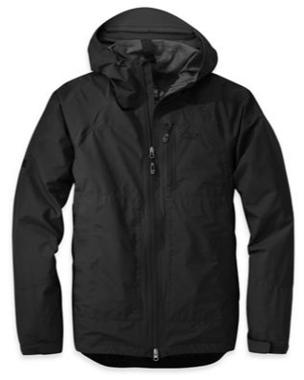
Challenge 1. Azure Cognitive services
Let’s create a model to identify if it’s a hard-shell or insulated jacket on a photo.
An insulated jacket is a general term to include the likes of synthetic insulated jackets and down jackets. These types of jackets are brilliant for freezing cold temperatures, as they offer a layer of body warming insulation that a waterproof jacket rarely offers.
A hard shell jacket is a waterproof jacket with a hood.

Slide 11
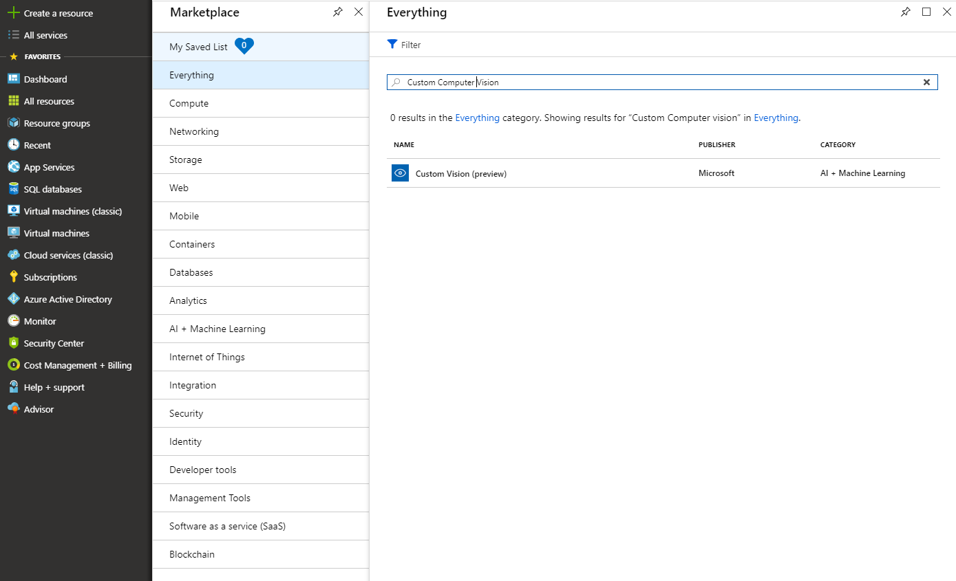
Challenge 1. Solution
Let’s use Azure Cognitive Services – Custom Vision https://customvision.ai
The Custom Vision Service is an Azure Cognitive Service that lets you build custom image classifiers. It makes it easy and fast to build, deploy, and improve an image classifier. The Custom Vision Service provides a REST API and a web interface to upload your images and train the classifier.

Slide 12
Challenge 1. Solution
import http.client, json
from IPython.display import Image
headers = {
# Request headers
'Prediction-Key’: ‘Prediction Key',
'Content-Type': 'application/json'
}
url = “Image URL"
body = '{"Url": "' + url + '"}'
display(Image(url=url, width=300, height=300))
request = 'https://southcentralus.api.cognitive.microsoft.com/customvision/v2.0/Prediction/…..'
try:
conn = http.client.HTTPSConnection('southcentralus.api.cognitive.microsoft.com')
conn.request("POST", request, body, headers)
response = conn.getresponse()
data = response.read()
predict = json.loads(str(data, 'utf-8'))
print ('This is ')
for prediction in predict["predictions"]:
print(' - {0} with probability {1:.3f}'.format(prediction["tagName"], prediction["probability"]))
conn.close()
except Exception as e:
print("[Errno {0}] {1}".format(e.errno, e.strerror))

Slide 13
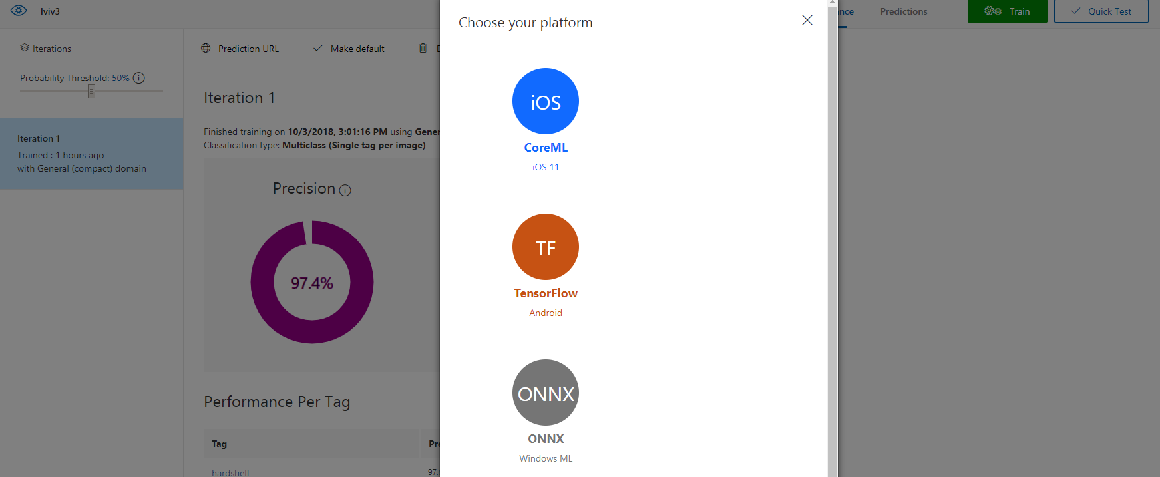
Challenge 1.1 Azure Cognitive Services. Offline
Let’s bring the model created on challenge 1 to the Edge.

Slide 14
Challenge 1.1 Solution
https://docs.microsoft.com/en-us/azure/cognitive-services/custom-vision-service/export-model-python
#
# aiworkshop challenge 1.1. Run downloaded model from Custom Vision
#
from IPython.display import Image
import tensorflow as tf
import os
from PIL import Image as Im
import numpy as np
import cv2
testimg = "aiworkshop/model/testimg.jpg"
model_file = "aiworkshop/model/model.pb"
labels_file = "aiworkshop/model/labels.txt"
# Display picture to recognize
display(Image(filename=testimg, width=300, height=300))
#
# Load saved Tensorflow model
#
graph_def = tf.GraphDef()
labels = []
# Import the TF graph
with tf.gfile.FastGFile(model_file, 'rb') as f:
graph_def.ParseFromString(f.read())
tf.import_graph_def(graph_def, name='')
# Create a list of labels.
with open(labels_file, 'rt') as lf:
for l in lf:
labels.append(l.strip())
#
# Image preparation helper functions
#
# ….
#
# Open and prepare the image for prediction
#
#...
#
# Make prediction and display the results
#
# These names are part of the model and cannot be changed.
output_layer = 'loss:0'
input_node = 'Placeholder:0'
with tf.Session() as sess:
prob_tensor = sess.graph.get_tensor_by_name(output_layer)
predictions, = sess.run(prob_tensor, {input_node: [augmented_image] })
# Print the highest probability label
highest_probability_index = np.argmax(predictions)
print('Classified as: ' + labels[highest_probability_index])
print()
# Print out all of the results mapping labels to probabilities.
label_index = 0
for p in predictions:
truncated_probablity = np.float64(round(p,8))
print (labels[label_index], truncated_probablity)
label_index += 1

Slide 15
Challenge 2: Image preprocessing
Transform the gear images into a particular format that can be used later on: 128x128x3 pixels (this means a 3-channel, 128x128 pixel square image - but please refrain from simply stretching the images).
Perform the following:
Pad the color images with the predominant background color and reshape, without stretching, to a 128x128x3 pixel array shape
"Stretch" the pixel range to be from 0 - 255 (inclusive or [0, 255])
Save the data to disk in a format for easily reading back in.

Slide 16
Challenge 3: scikit-learn
Perform the following:
Choose an algorithm from scikit-learn documentation
Train the model with the preprocessed image array data from Challenge 2
Predict the class of the following piece of gear with the model: https://shop.epictv.com/sites/default/files/ae42ad29e70ba8ce6b67d3bdb6ab5c6e.jpeg
Using your methods from Challenge 2, preprocess the test set.
Evaluate the model with a confusion matrix to see how individual classes performed (use test set)
Output the overall accuracy (use test set)

Slide 17
Challenge 4: Convolutional Neural Networks
Create a Convolutional Neural Network (a deep learning architecture) to classify the gear data.
The architecture or design should contain a mix of layers such as convolutional and pooling.
Train a model on the training dataset using the decided architecture. You may have to iterate on the architecture. Make sure the best trained model is saved to disk.

Slide 18
Challenge 5. Making AI Operational
# Use an official Python runtime as a parent image
FROM python:3.6-stretch
# Set the working directory to /app
WORKDIR /app
# Copy the current directory contents into the container at /app
ADD . /app
# Install any needed packages specified in requirements.txt
RUN pip install --trusted-host pypi.python.org -r requirements.txt
# Make port 80 available to the world outside this container
EXPOSE 80
# Define environment variable
ENV NAME World
# Run app.py when the container launches
CMD ["python", "app.py"]
## 1. Building Docker image
# create empty folder (Challenge5); copy trained model, app.py, Dockerfile
# Building Docker image. Make sure to tun it in the filder with Dockerfile
docker build -t aimodel .
# 2. Cerating Azure Container Registry
# Login to Azure
az login
az configure # set defualt output to table and location westeurope
az account list # make sure the right subscription is user by default
az group create --name "vtsykun-ml-service"
az acr create --name vtsykuntestml --sku Basic -g "vtsykun-ml-service"
az acr login --name vtsykuntestml
az acr update --name vtsykuntestml --admin-enabled true
az acr credential show --name vtsykuntestml --query "passwords[0].value"
-> "record this password"
az acr list --query "[].{acrLoginServer:loginServer}"
-> "vtsykuntestml.azurecr.io" # record login server name
# 3. Tag and push image to the new repository
docker images
docker tag aimodel vtsykuntestml.azurecr.io/aimodel:v1
docker push vtsykuntestml.azurecr.io/aimodel:v1
# 4. Check if container is in the registry and craete container
az acr repository list --name vtsykuntestml
az container create --name vtsykuntestml -g "vtsykun-ml-service" --image vtsykuntestml.azurecr.io/aimodel:v1 --ip-address public --ports 8080 --cpu 2 --memory 8
# 5. Working with containers
az container attach --name vtsykuntestml # read logs
az container list # list of ruuning containers
az container delete --name vtsykuntestml -g "vtsykun-ml-service" # delete running container

Slide 19
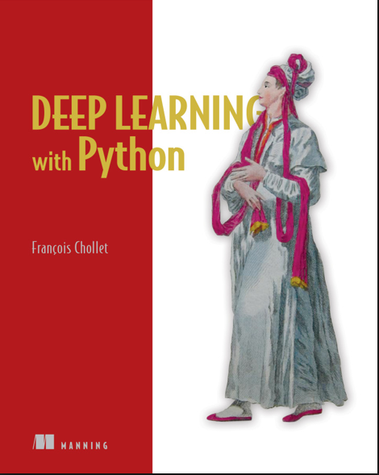
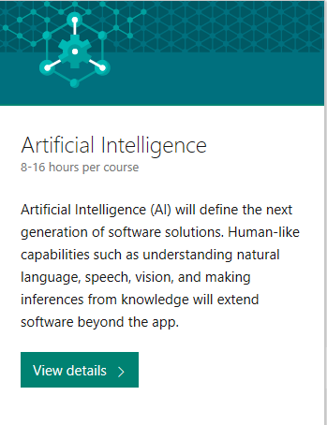
Next Steps
https://play.google.com/store/books/details/Глубокое_обучение_на_Python?id=97ZaDwAAQBAJ&hl=en_US
https://academy.microsoft.com/en-us/professional-program/

